Slide 1
The World as Will and Representation

Slide 2
The World as Will and Representation
Not merely that the world exists, but still more that it is such a miserable and melancholy world, is the tormenting problem of metaphysics.”

Slide 3
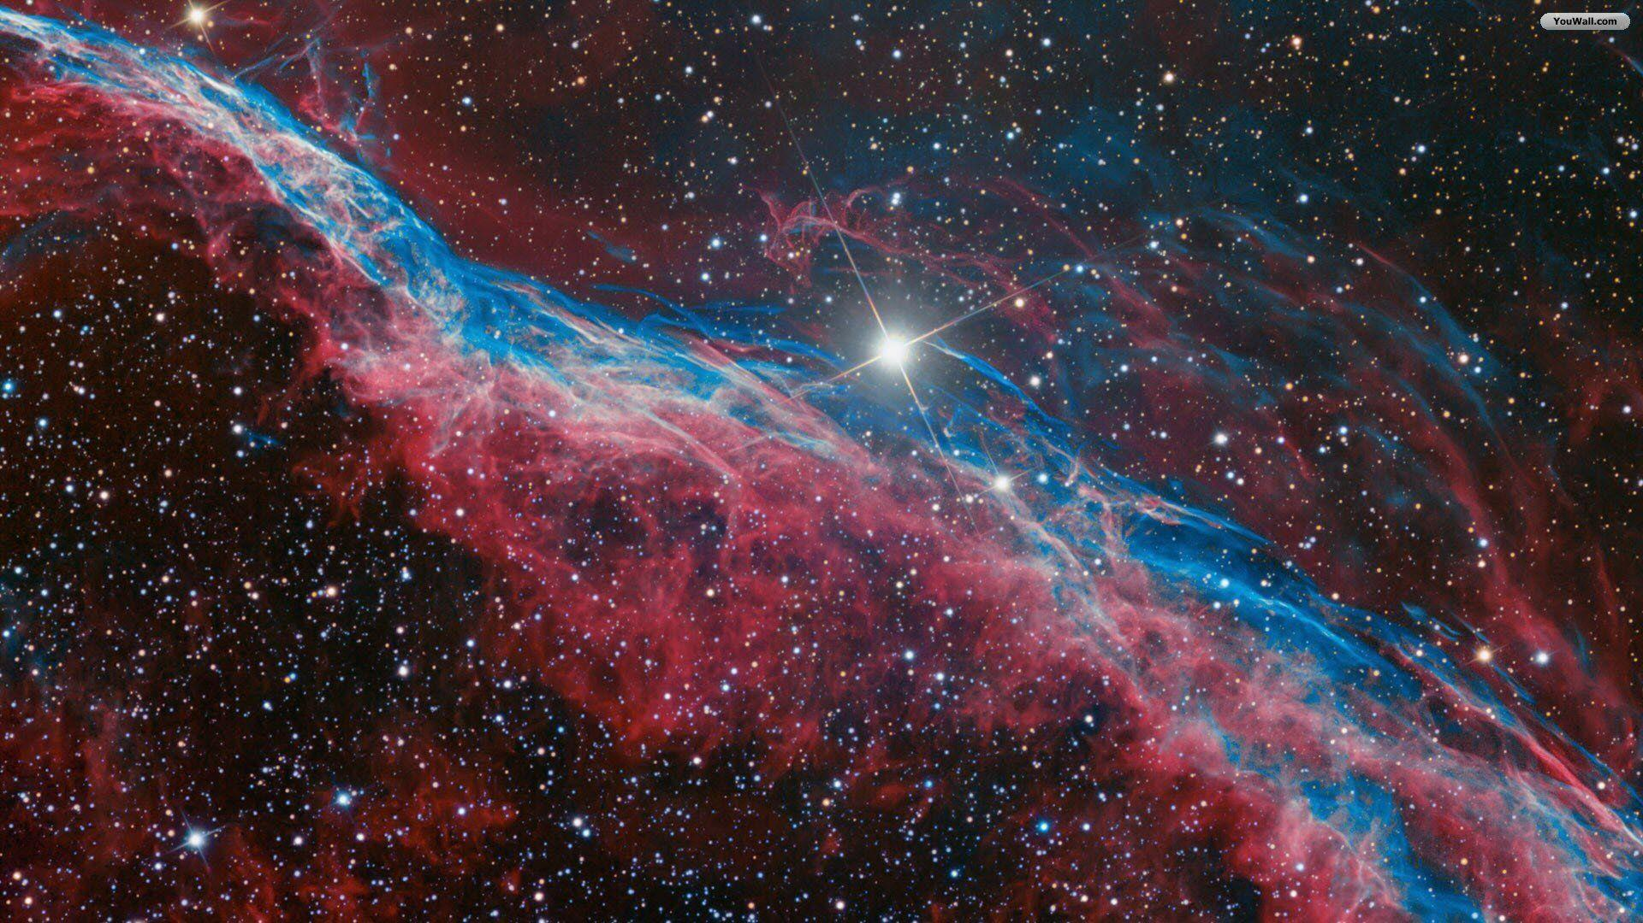
Will
“Will for life is the most real of all things that we know, indeed the core of reality itself”
“What will aims at and achieves in human beings is indeed essentially no more than its goal in animals: nourishment and propagation. But through the organizations of the human beings, the requirements of achievement of that goal were so greatly enhanced that an enhancements of the intellect was necessary”

Slide 4
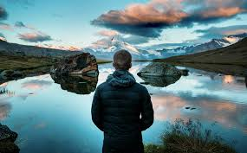
“The lower a man is in an intellectual respect, the less puzzling and mysterious existence is to him; on the contrary, everything, how it is and that it is, seems to him a matter of course.”
“…if accordingly we attempt to imagine an objective world without a knowing subject, then we become aware that what we are imagining at that moment is in truth the opposite of what we intended, namely nothing but just the process in the intellect of a knowing being who perceives an objective world...”

Slide 5
“what we discover when we look closely at our wills is that they are governed not by reason but by impulse, at its most fundamental level a “dark, dull driving”, and even at its highest, most clarified level, still desires or apparently “creative drives”

Slide 6
Desire
“Every satisfaction he attains lays the seeds of some new desire, so there is no end to the wishes of each individual will”

Slide 7
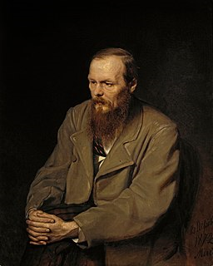
Delusional Belief “…its desires are unlimited, it’s claims inexhaustible, and every satisfied desire gives birth to a new one. No possible satisfaction in the world could suffice to still its craving, set a final goal to its demands, and fill the bottomless pit of its heart.”

Slide 8
“Homo homini lupus”
“…the principal source of the most serious ills that afflicted human being is human beings themselves: homo homini lupus”
“…as a rule, injustice, extreme unfairness, callousness, indeed cruelty characterize people’s conduct toward one another: the opposite occurs only as an exception”

Slide 9
“All satisfaction, or what one commonly calls happiness, is really and essentially always only negative and never at all positive. It is not a gratification that come to us originally and of itself, but must always be the satisfaction of a desire… “
“All willing springs from lack, from deficiency, and thus from suffering”

Slide 10
Will to Live
“…nothing other can be stated as the purpose of our existence than cognizance of the fact that it would be better had we not existed”

